Slide 1
TASK 2

Slide 2
Title: Cross Site Scripting
Domain: vulnweb.com
Sub Domain: testasp.vulnweb.com
Reporting by: Satya Krishna
Severity: Medium
Summary: A Reflected Cross-Site Scripting (XSS) bug was found on testasp.vulnweb.com, permitting an attacker to inject and run arbitrary JavaScript within a victim's browser. This may result in session hijacking, phishing, or unauthorized activities being carried out on the user's behalf.
Affected URL: http://testasp.vulnweb.com/Search.asp?tfSearch=%3Cscript%3E+alert%28%22XSS%22%29+%3C%2Fscript%3E

Slide 3
Steps to Reproduce:
Visit http://testasp.vulnweb.com/
Find the search button and click it, enter the following java-script payload:
<script>alert('XSS');</script>
Observe that the injected JavaScript executes in the browser without sanitization.
This confirms the presence of a Reflected XSS vulnerability.
IMPACT:
Session Hijacking: Attackers may intercept session cookies, resulting in unauthorized access to user accounts.
Phishing Attacks: An attacker could inject malicious scripts to display fake login forms, tricking users into entering their credentials.
Defacement & Redirection: Attackers might alter the content of the page or redirect them to malicious websites.
Recommended Fixes:
Input Validation: Use server-side validation to block malicious inputs.
Use Content Security Policy (CSP): Implement a strong CSP to mitigate script execution.

Slide 4
The provided report contains a Proof of Concept (PoC) that exhibits the vulnerability and evidence in screenshots and a screen recording. These visual proofs exhibit the exploitation method and validate the existence of the security flaw.

Slide 5
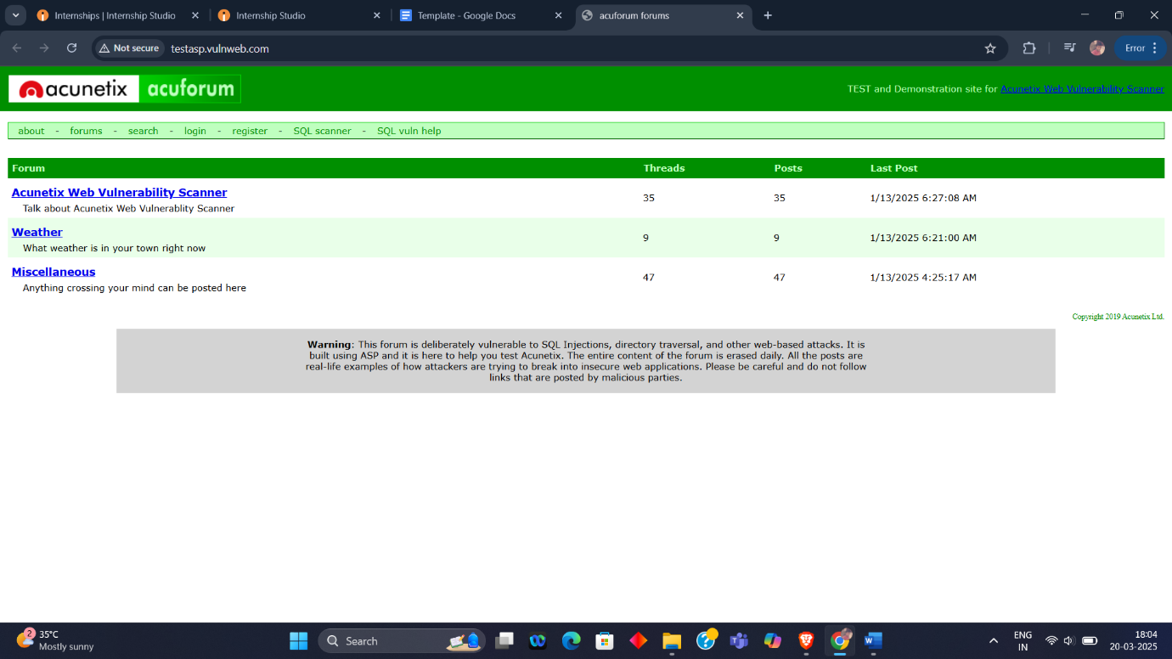
Homepage

Slide 6
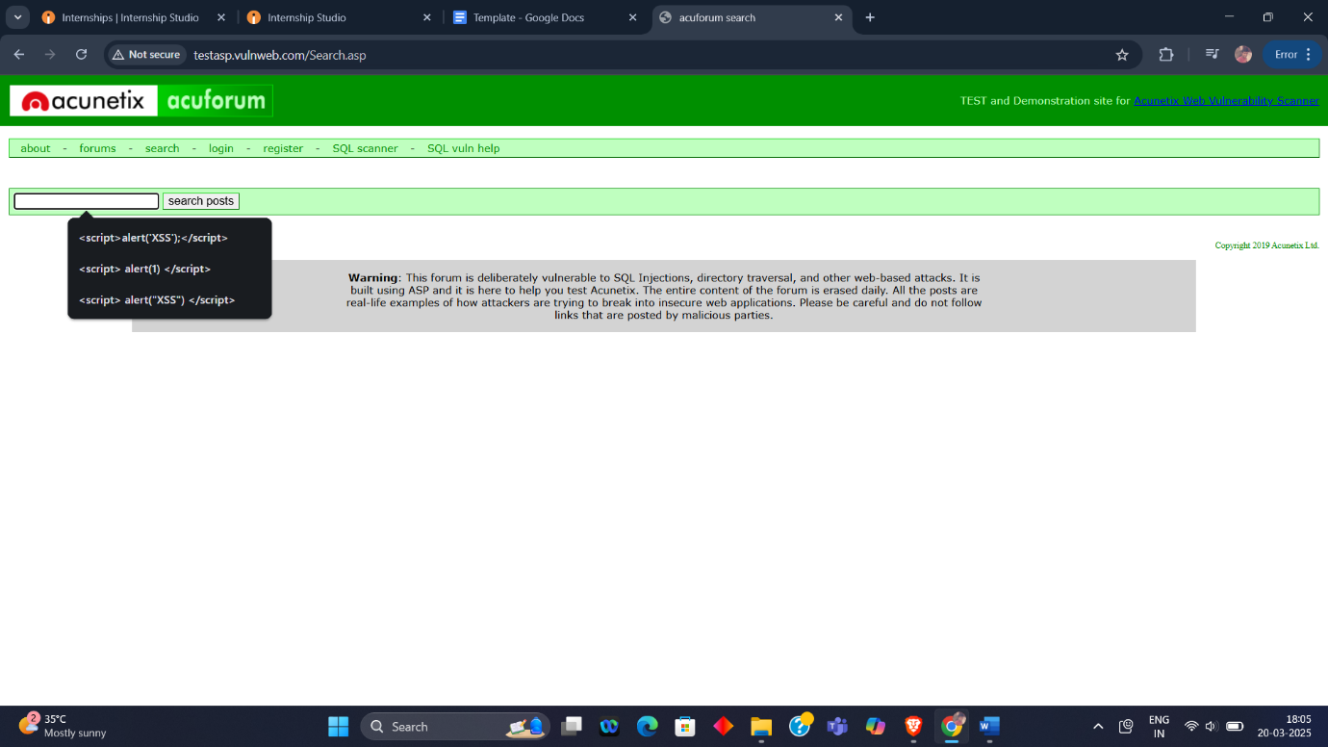
Search page

Slide 7
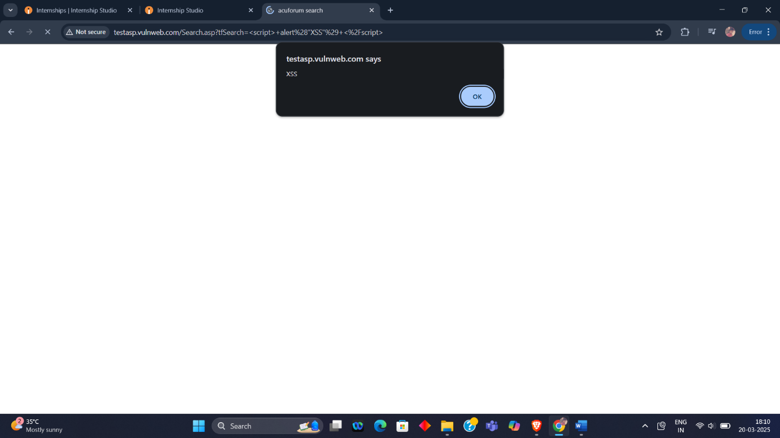
After entering the small java-script payload in the search box and hit enter. It’ll show alert after loading

Slide 8
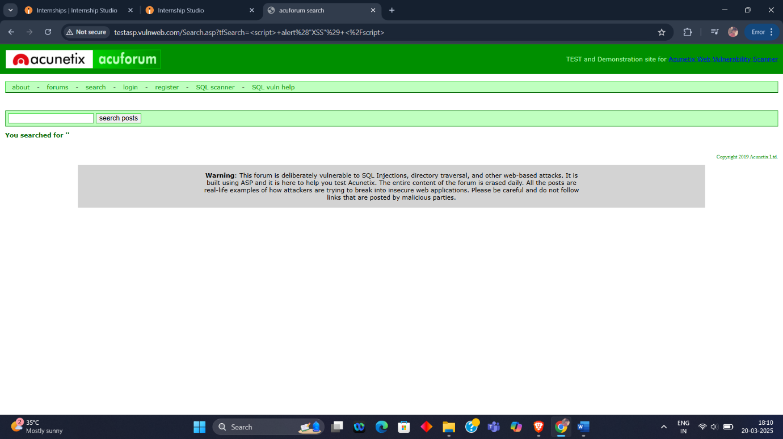

Slide 9
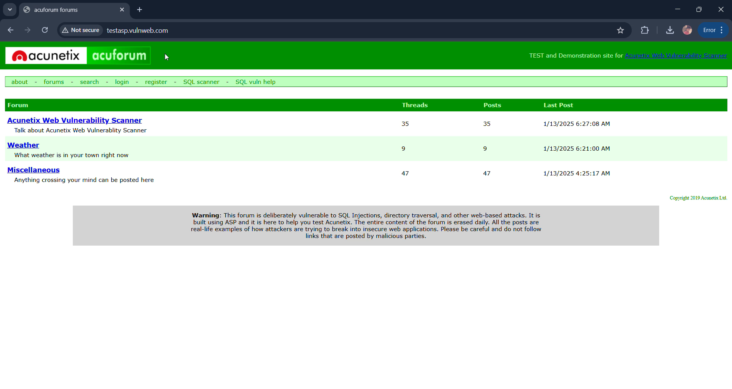
Video

Slide 10
Conclusion
This flaw enables attackers to run arbitrary JavaScript in the user's session context. If exploited, it can result in account takeover, phishing, and data theft. Remediation is advised immediately to avoid potential security risks.

